Slide 1

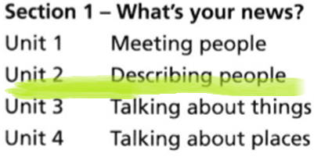

WEEK-1

Slide 2

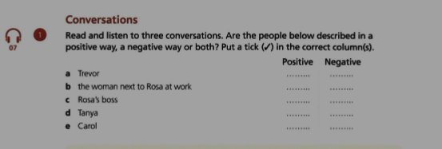

00.46-1.48

Slide 3
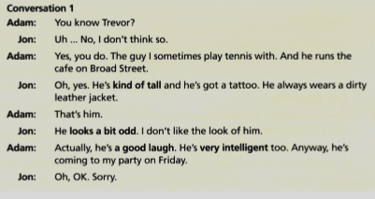

Slide 4
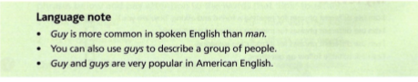
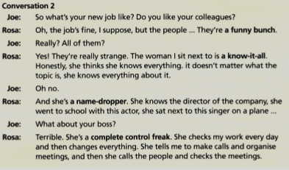

Slide 5
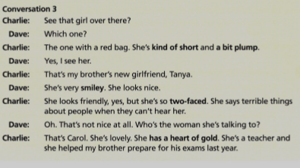

Slide 6
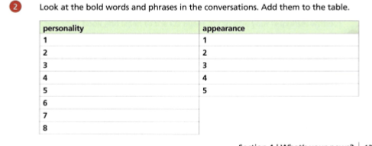
HOMEWORK

Slide 7
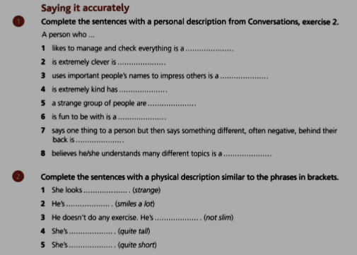
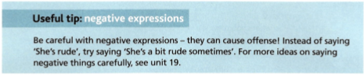

Slide 8
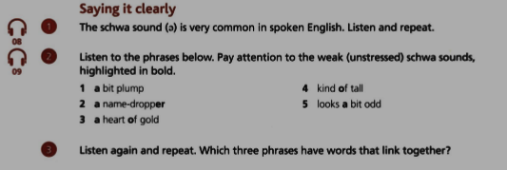

Slide 9
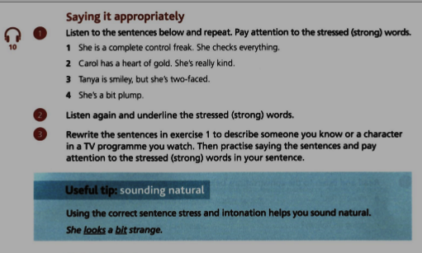

Slide 10
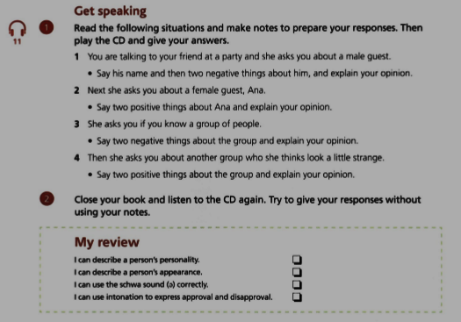

Slide 11
https://www.youtube.com/watch?v=x0YQX7gGkQs
https://www.youtube.com/watch?v=7bdRcIpN1jU
https://www.youtube.com/watch?v=R3KeD06ti6c
https://www.youtube.com/watch?v=FfhZFRvmaVY&list=PLD_5T89Ssbn0FbigKmfNXTbQ-bRnWzI57&index=2
https://learnenglishteens.britishcouncil.org/grammar/a1-a2-grammar/present-continuous

